Slide 1

Air, Water, Land and life is a gift from earth

Slide 2
TABLE OF CONTENTS
Team 12
Mpilenhle
Rebecca
Sello
Blessing
1. Introduction
2. Problem Overview
3. The Data Science Process
3.1. Data Collection
3.2. Data Cleaning
3.3. Exploratory Data Analysis
3.4. Model Building
3.5. Model Deployment
4. Conclusion

Slide 3
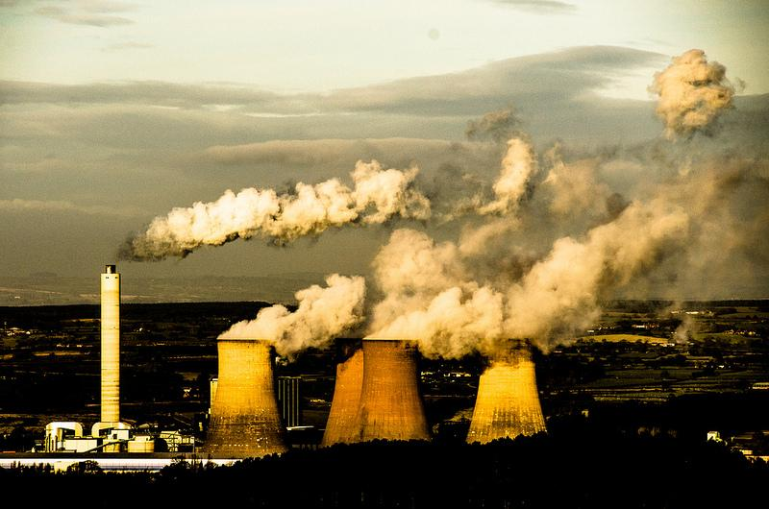
1. INTRODUCTION
The production Industries are one of the major contributors to the carbon footprint
CARBON FOOTPRINTS
every service uses dumping
1. Air Pollution
2. Land Pollution
3. Water Pollution

Slide 4
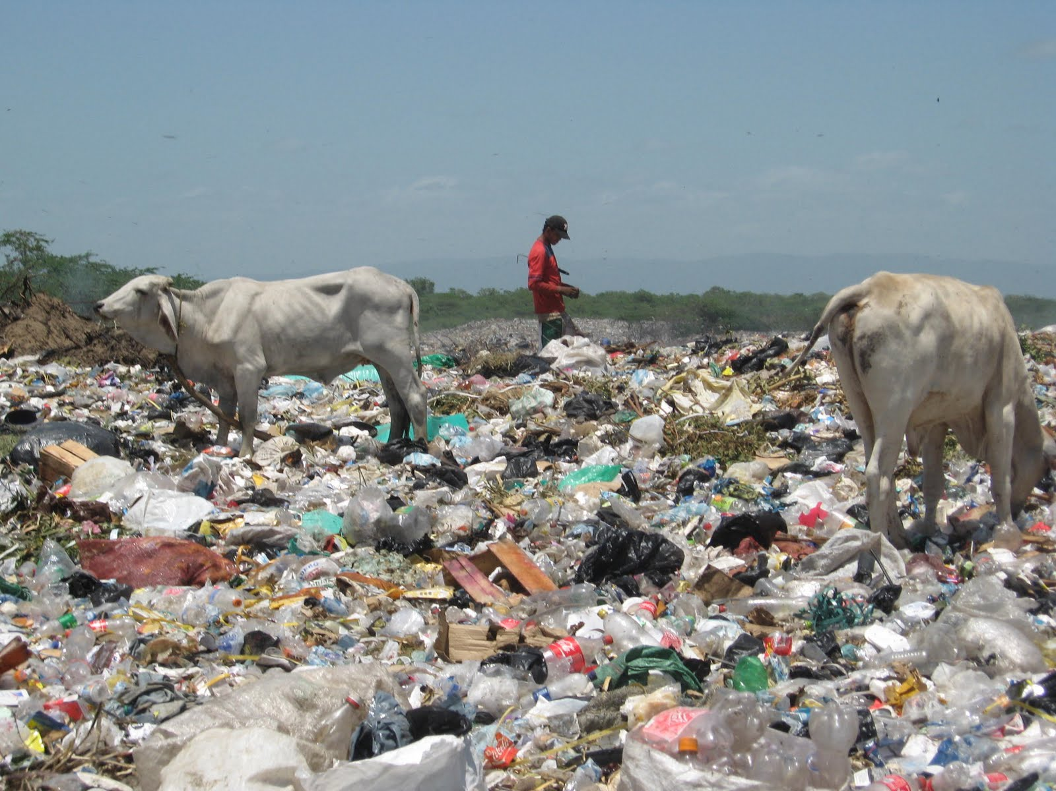
9% recycled, 12% burnt and 79% landfills, if not home
1. INTRODUCTION
CARBON FOOTPRINTS
1. Air Pollution
2. Land Pollution
3. Water Pollution

Slide 5

1. INTRODUCTION
CARBON FOOTPRINTS
1. Air Pollution
2. Land Pollution
3. Water Pollution
The sea is has become the most dangerous of places even for the marine life, because of acid

Slide 6
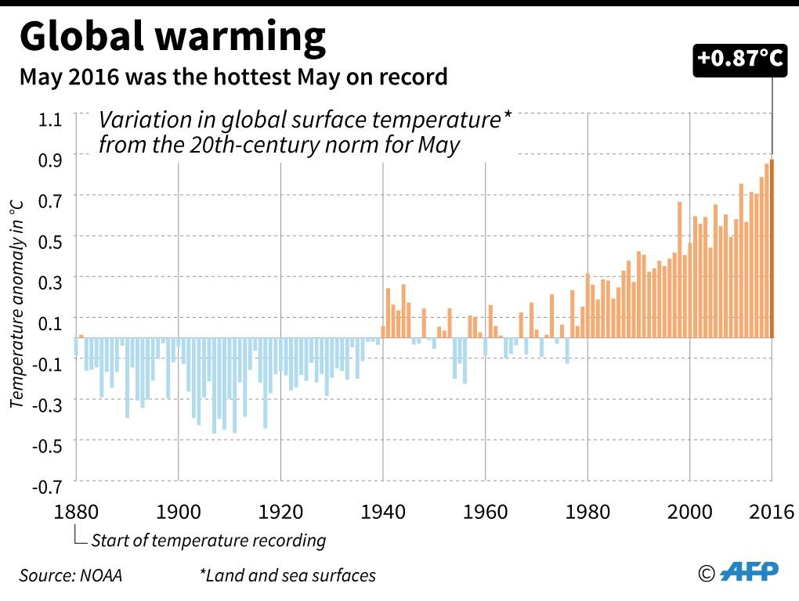
2. PROBLEM OVERVIEW
CARBON FOOTPRINTS Impacts
1. Rising temperatures
2. Soil Pollution
3. Aquatic life extinction
4. Health
5. Eco Friendly Product
in hospitals if in intensive care
The graph shows an increase in the temperature from 1880 to the year 2016, which is by far the hottest may, from the graph

Slide 7
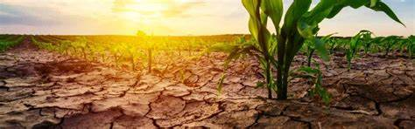
2. PROBLEM OVERVIEW
CARBON FOOTPRINTS Impacts
1. Rising temperatures
2. Drought
3. Aquatic life extinction
4. Health
5. Eco Friendly Product
in hospitals if in intensive care
Since the climate is changing this means there will be rains that will not be coming at their regular seasons

Slide 8

2. PROBLEM OVERVIEW
CARBON FOOTPRINTS Impacts
1. Rising temperatures
2. Soil Pollution
3. Aquatic life extinction
4. Health
5. Eco Friendly Product
in hospitals if in intensive care
80% of marine pollution originates on land, from human activities

Slide 9
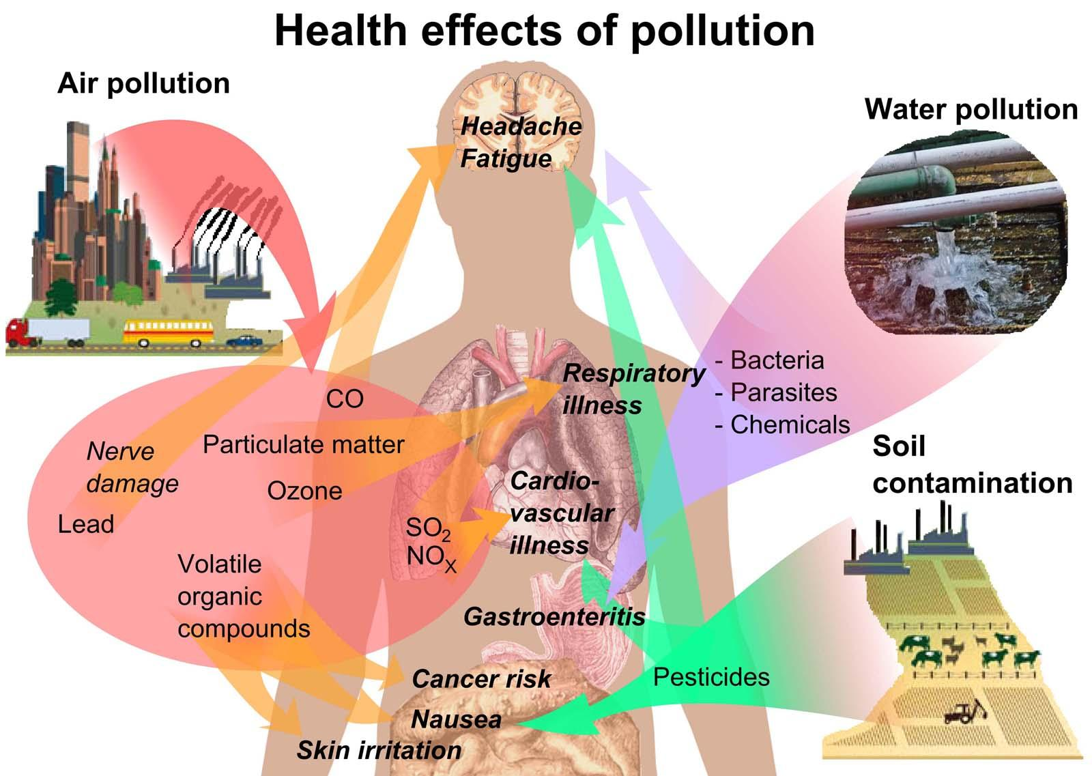
2. PROBLEM OVERVIEW
CARBON FOOTPRINTS Impacts
1. Rising temperatures
2. Soil Pollution
3. Aquatic life extinction
4. Health
5. Eco Friendly Product
in hospitals if in intensive care
Each and every type of pollution there is also contributes to the illness in it’s own way, from food, water and Air, this is a major problem

Slide 10






2. PROBLEM OVERVIEW
CARBON FOOTPRINTS Impacts
1. Rising temperatures
2. Soil Pollution
3. Aquatic life extinction
4. Health
5. Eco Friendly Product
. market
. sentiment predict
in hospitals if in intensive care
Each and every type of pollution there is also contributes to the illness in it’s own way, from food, water and Air, this is a major problem

Slide 11
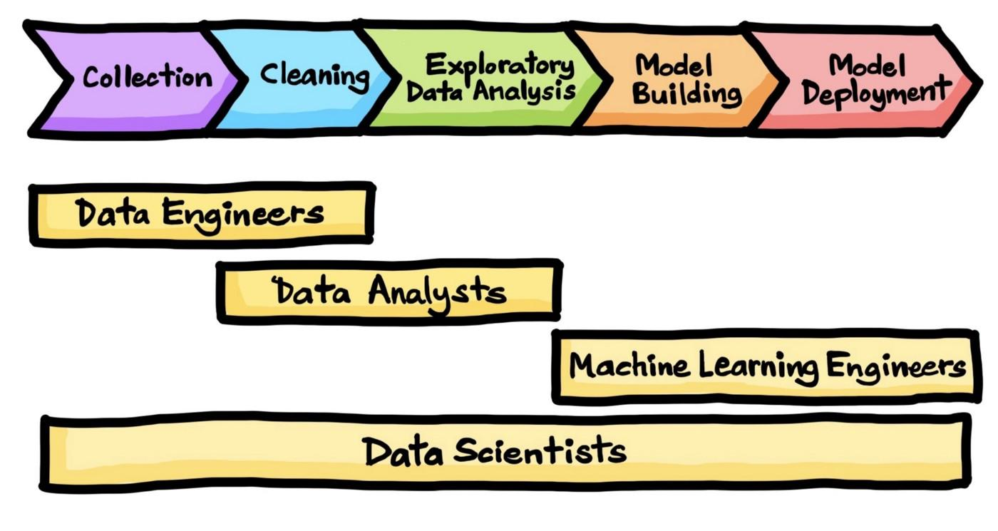
3. THE DATA SCIENCE PROCESS
The data science process is the framework we used to solve the Spain Electricity shortfall
Step 1:
Data can be collected in many different ways.
It can be stored in a database and exported as a csv.
Step 3:
This phase helps us to understand patterns in our data, the most trending information
Step 5:
This phase takes the trained model from phase 4 and makes it available in a production environment.
Step 2:
Cleaning the data will consist of removing urls, numbers and emojis
Stepour model on the input data. Build different models for traiining our model

Slide 12
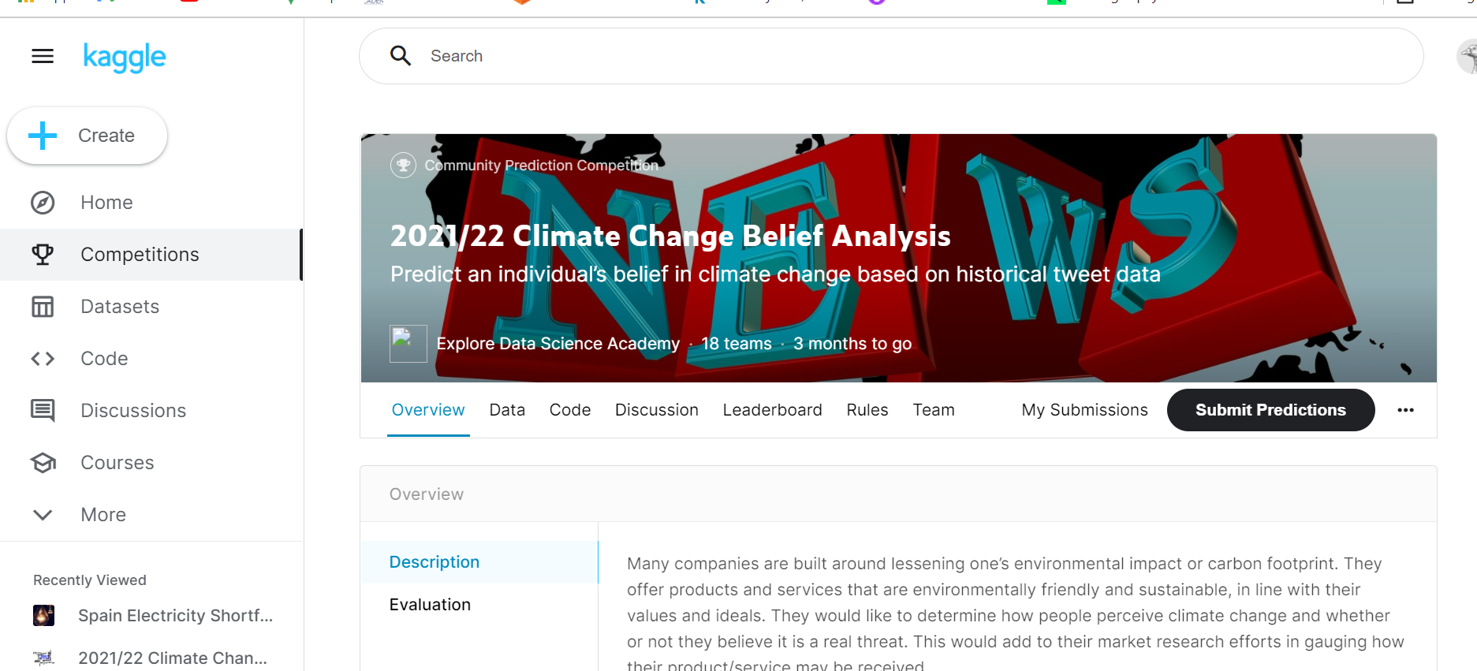
3.1 DATA COLLECTION
For the Spain Electricity Shortfall Challenge, the data is downloaded from the Kaggle website as a csv file.

Slide 13
3.2 DATA CLEANING
The removal of urls
removing emojis
removing the numbers
remove the hashtags
remove the RT
remove the @ mentions

Slide 14
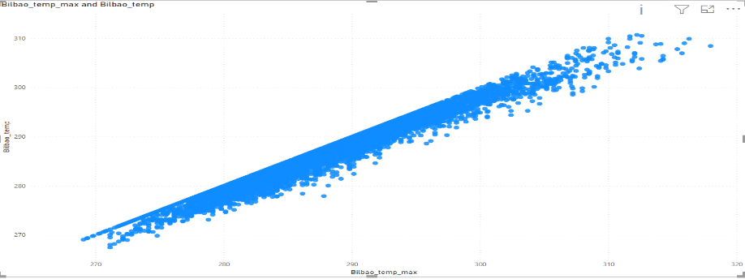
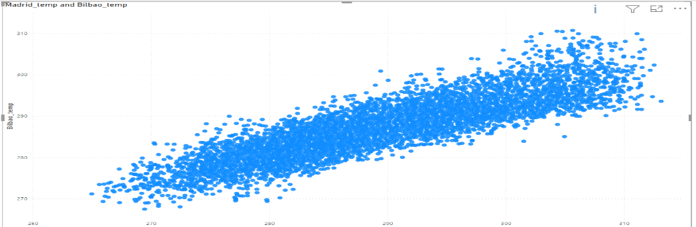
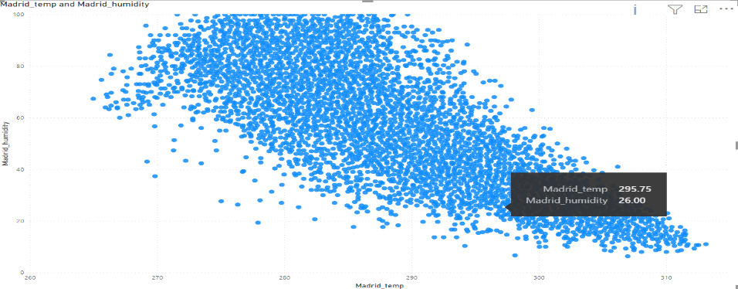
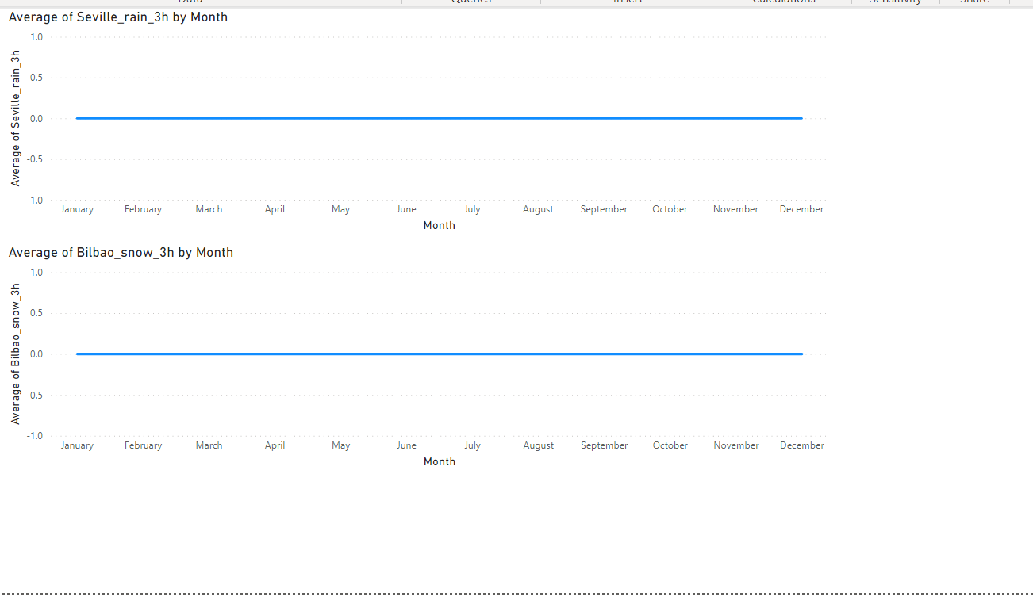
3.3 EXPLORATORY DATA ANALYSIS

Slide 15
3.3 Feature Engineering

Slide 16
FEATURE ENGINEERING
Transformed the variable time (hours, Day, Month, Year
Dropped time variable
variable using standard scaler

Slide 17
3.4 MODEL BUILDING
Feature Engineering
Feature Selection
Types of models used
Model Perfomance

Slide 18
FEATURE SELECTION
Recursive Feature elimination Method
Variable Correlation
Measured multicollinearity
Dropped feature > 0.5
Feature Importance
variable XGBOOST – regressor to asses feature importance f-score

Slide 19
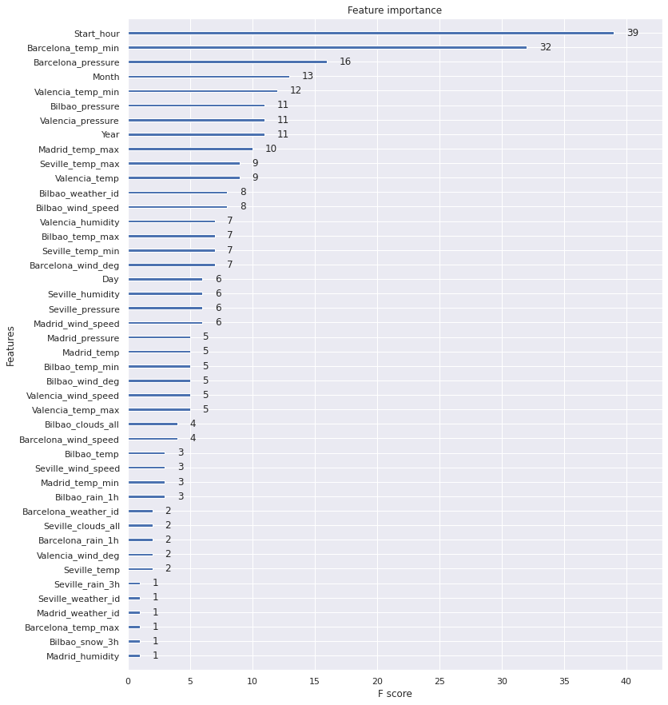
FEATURE Importance

Slide 20
MODEL PERFORMANCE
01
TRAINING RMSE: 1540.99
TESTING: RMSE: 2799.03
R2 SCORE: 0.719288
Random Forest Regressor
02
TRAINING RMSE: 1083.4
TESTING: RMSE: 2937.68
R2 SCORE: 0.690789
Xgboost Regressor

Slide 21

3.5 MODEL DEPLOYMENT
API
Host
client

Slide 22
4. CONCLUSION
The complexity of the model does not mean better performance
The temperature level seems to be the best predictor of load
Time plays a huge role in predicting the load

